Slide 1

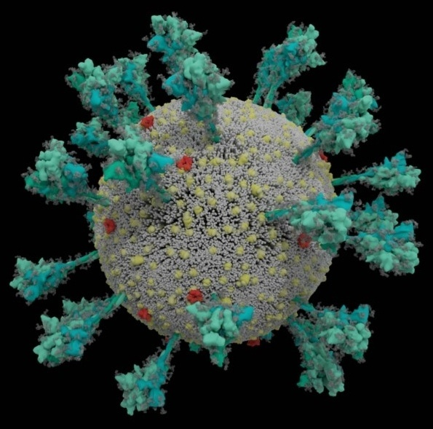
Covid 2021

Slide 2
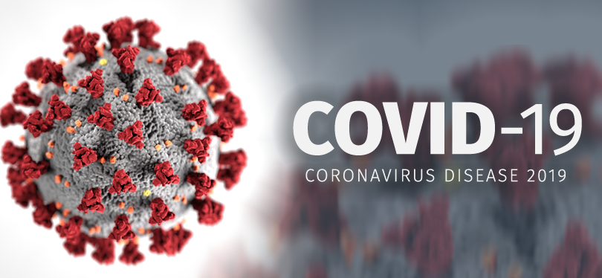
By Raymond K.J. Chang, M.D.
January 6, 2020

Slide 3
1918 Pandemic
WWI
Influenza outbreak, Spanish flu, spread from troop to troop
Movement of the troops spread the virus
Origination is unknown. Possibly Madrid, King of Spain was infected = Spanish Flu
Traced back to Avian origin, H1N1
H1N1 Epidemic but with WWI became pandemic
Started winter and gradually died down in the summer
However, second wave hit as it approached winter 1918 more deadly! A devastating wave of infection.

Slide 4
How does covid-19 kill you?
As the novel coronavirus, SARS-CoV-2 enters the nose and throat via ACE2 receptor, it hijacks the cell’s machinery, making myriad copies of itself and invading new cells.
As the virus multiples, an infected person may shed copious amounts of it, especially during the first week or so. Patient may be asymptomatic or may develop fever, dry cough, loss of smell or taste…etc.
If the immune system doesn’t fight back during this initial phase, the virus then disseminates down the wind pipe to attack the lungs and the patient starts to manifest with SOB and desaturation.

Slide 5
How does covid-19 kill you?
As the immune system starts to attack the virus, the WBC releases inflammatory molecules, which in turn summon more immune cells that kills virus-infected cells, leaving a stew of fluid and dead cells→pus, we call pneumonia.
This can further deteriorate and develop ARDS! Oxygen levels in blood plummet making it harder to breathe.
The body immune system over reacts as the patient is gets sicker and virus load continues to increase. The immune cells start to attack healthy tissues with overreacted immune response called cytokine storm

Slide 6
How does covid-19 kill you?
Another mechanism of how covid-19 patient die is their body becomes hypercoagulable and blood clots are formed as patient gets sicker. The clots can break apart and travel distally blocking vital arteries, a condition know as pulmonary embolism. It can also dislodge in the brain causing stroke. A serial D-dimer level can help us detect and guide our plan of care accordingly.
Infection may also lead to blood vessel constriction, ischemia in the fingers and toes, a reduction in blood flow that can lead to swollen painful digits and tissue death.

Slide 7
How does covid-19 kill you?
Another organ in our body other than the alveoli in the lung that has abundant amount of ACE2 receptors is the kidneys! Those with AKI are more than 5x likely to die as to the patient without renal failure. Reason is that both organs balance our body acid-base and if both fail the chance of survival is slim, CRRT ultimately may be required in addition to mechanical ventilation.
ACE2 receptors also abundantly distributed throughout our body including brain, GI, eye, liver and fat cell…etc.
The greatest mimicker of all history of medicine

Slide 8
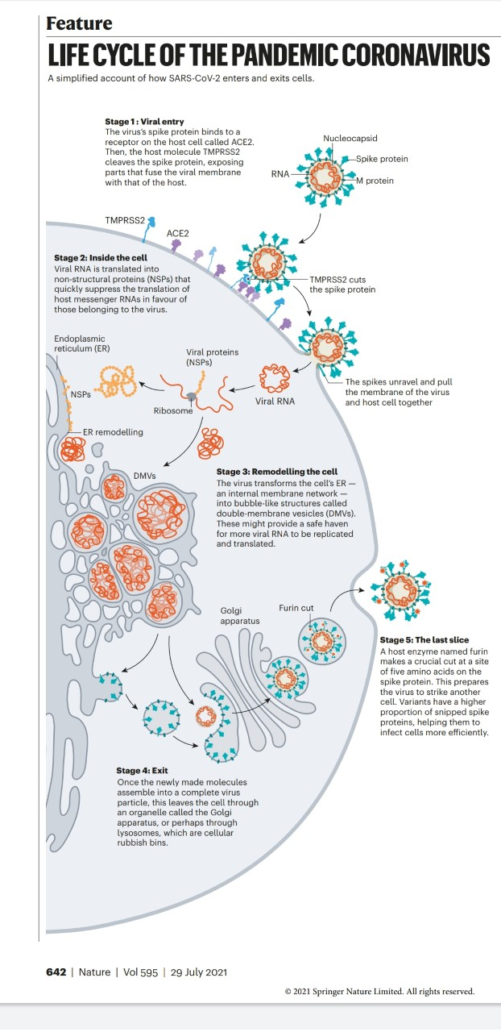

Slide 9
COVID-21
(A continuum of COVID-19)
Diseases are not static things! Pathogens evolve and mutate! Hosts adapt and react! In the case of COVID-19, in some ways its is already over…What lies ahead is
COVID-21
COVID-21 is the results of all changes of COVID-19, with new variants of the virus, political challenges, anti-mask and unvaccinated protesters, decisions to vaccinate or NOT. We are not just dealing with the deadly COVID-19 only. We are no longer in a Pandemic, we are evolving to an endemic.

Slide 10
COVID-21
(A continuum of COVID-19)
B
#1.Which country has the most covid vaccinated patients?
United States
Singapore
India
United Kingdom
Israel
Singapore (as of 09/2021) has become the most fully vaccinated country in the world

Slide 11
COVID-21
(A continuum of COVID-19)
D
#2. What are the odds of getting severe COVID-19 symptoms?
1 in 2
1 in 3
1 in 4
1 in 5
1 in 6
Most people will have mild symptoms and get better on their own. But 1 in 6 will have severe problems i.e. trouble breathing.

Slide 12
COVID-21
(A continuum of COVID-19)
D
#3. What are the odds of getting COVID with COVID-19 vaccine?
A. 10%
B. 5%
C. 50%
D. <1%

Slide 13
COVID-21
(A continuum of COVID-19)
C
#4. If a patient tested positive for COVID-19 but is asymptomatic, how many days does the patient need to stay isolated?
14 days
B. 7 days
C. 10 days
D. No need for isolation since patient is asymptomatic

Slide 14
COVID-21
(A continuum of COVID-19)
#5. Is there a difference between a booster and COVID-19 vaccine shot?
Ans. The dosages are the same

Slide 15
COVID-21
(A continuum of COVID-19)
#6. Why get vaccinated if I have antibodies?
Ans: Multiple studies have shown that even a single dose of an mRNA vaccine boosts antibody levels in recovered patient giving them the same peak response that 2 shots afford people who haven’t had the disease

Slide 16
A
COVID-21
(A continuum of COVID-19)
#7. As of 09/2021, what percent of people hospitalized for COVID-19 in the U.S. are unvaccinated?
A.97%
67%
50%
D.33%

Slide 17
COVID-21
(A continuum of COVID-19)
#8. Are antibodies from the COVID-19 vaccine passed from mother to child?
Ans. Vaccine-generated antibodies were also present in all umbilical cord blood and breast milk samples taken from the study, showing the transfer of antibodies from mothers to newborns

Slide 18
COVID-21
(A continuum of COVID-19)
#9. Can COVID-19 vaccines cause male fertility problems?
Ans. Currently no evidence shows that any vaccines, including COVID-19 vaccines, cause male fertility problems

Slide 19
E
COVID-21
(A continuum of COVID-19)
#10. What is Baricitinib (Olumiant)?
A. FDA issued and EUA for baricitinib, an immune modulator in combination with Remdesivir for treatment of suspected or lab confirmed COVID-19 in hospitalized adults and pediatric patient 2 years of age or older and requiring supplemental oxygen, mechanical ventilation or ECMO.
  B. It is a JAK inhibitor
C. JAK mediates the effects of cytokines and their production; thus, JAK inhibitors inhibit multiple cytokines
D. Baricitinib is a selective Janus Kinase (JAK1/JAK2) inhibitor with a known anti- inflammatory profile in patients with autoimmune diseases.
E. All of the above are true

Slide 20
F
COVID-21
(A continuum of COVID-19)
#11. Which of the following statement(s) regarding Delta variant is (are) true?
A. It was first identified in India in December 2020
B. CDC described Delta as more transmissible than the common cold and influenza, as well as the viruses that cause small pox, MERS, SARS, and Ebola. It is as contagious as chicken pox.
C. Besides Delta variant, there are also alpha strain (Great Britain), Beta Strain (South Africa), Gamma strain (Brazil), Lambda variant (Peru)…etc.
D. When infected with the delta variant, they found similar viral loads in vaccinated and unvaccinated patients, but the viral loads decreased faster in the vaccinated group.
E. There is still more to learn about delta, it could lead to hyperlocal outbreaks! Vaccination is the best protection against it!
F. All of the above are true

Slide 21
COVID-21
(A continuum of COVID-19)
#12. Does the 3rd mRNA dose boost the antibody quantity, quality of both?
Answer: Quantity

Slide 22
COVID-21
(A continuum of COVID-19)
#13. Is the Lambda variant more virulent than Delta?
Ans: No, but it has at least more than 150 cased reported in CA, Delta variant still dominates

Slide 23
COVID-21
(A continuum of COVID-19)
#14. What is COVID C.1.2 Variant?
Ans: A new variant first found in South Africa, it possesses large numbers of mutations but does not appear to be spreading as fast, it has been flagged as ”concerning” for now.

Slide 24
E
COVID-21
(A continuum of COVID-19)
#15. As of September 2021, what percent of COVID-19 deaths are occurring in unvaccinated people?
A. 5%
B. 25%
C. 50%
D. 67%
E. 99%

Slide 25
COVID-21
(A continuum of COVID-19)
#16. What is Selenium role in COVID-19?
Ans: Some studies have shown that Selenium deficiency may be associated with COVID-19 risk, there is a hypothesis that Selenium supplements might help with COVID-19 but it has not yet been studied in humans for treating COVID-19.

Slide 26
COVID-21
(A continuum of COVID-19)
#17. Which of the following is/are true regarding types of masks against COVID 19?
A. N95 still the most effective while knitted masks, bandanas, fleece neck gaiters have higher levels of droplet transmission.
B. All Mask types reduce the droplet transmission compared to no mask at all, with the exception of the gaiter type neck fleece which appears to cause the largest droplets to disperse into a multitude of smaller droplets, and since those smaller droplets can remain airborne longer, the fleece neck gaiter type of masks should be avoided
C. Both A&B are true
D. Both A&B are false

Slide 27
COVID-21
(A continuum of COVID-19)
#18. How much will it cost to get the COVID-19 vaccine?
Ans: The U.S. government is providing the COVID-19 vaccine free of charge to all people living in the U.S. regardless of their immigration or health insurance status.

Slide 28
COVID-21
(A continuum of COVID-19)
#19. Should you take pain relievers before COVID Vaccine?
Ans: The CDC currently recommends against taking any pain relievers before you get a COVID-19 vaccine.
#20. Does the COVID Vaccine impact menstruation?
Ans: No

Slide 29
COVID-21
(A continuum of COVID-19)
#21. Can I get the COVID-19 vaccine if my immune system is compromised?
Ans: CDC recommends that people with moderately to severely compromised immune systems received an additional dose of mRNA COVID-19 vaccine at least 4 weeks after a second dose of Pfizer or Moderna COVID-19 vaccine.

Slide 30
E
COVID-21
(A continuum of COVID-19)
#22. Which autoimmune conditions have been linked to COVID-19 infection?
A. GBS
B. ITP
C. Diabetes
D. Autoimmune hemolytic anemia
E. All of the above

Slide 31
COVID-21
(A continuum of COVID-19)
#23. Will I develop a thyroid disorder if I get a COVID-19 vaccine?
Ans: There are rare reports of people developing thyroid disorders after receiving the vaccine. (Subacute thyroiditis, Grave’s disease have been reported)

Slide 32
COVID-21
(A continuum of COVID-19)
#24. Is hydroxychloroquine safe and effective for treating COVID-19?
Ans: In an article published in December 2020 in JAMA, Hydroxychloroquine did not result in any clinical benefits for adults hospitalized with respiratory illness from COVID-19, compared with placebo. The NIH treatment guidelines recommend against the use of hydroxychloroquine for COVID-19 in both hospitalized and non-hospitalized patients.

Slide 33
D
COVID-21
(A continuum of COVID-19)
#25. Which of the following medications is the best choice for COVID positive (8 days) patient with mild symptoms, underlying CKD and diabetes, patient is SOB but not requiring oxygen.
A. Tocilizumab
B. Lenzilumab
C. BAM
D. Casirivimab and imdevimab

Slide 34
B
COVID-21
(A continuum of COVID-19)
#26. Which of the following medication is the best choice for a patient with COVID positive, SOB, requiring oxygen but CRP< 150, not requiring mechanical ventilation yet.
A. Tocilizumab
B. Lenzilumab
C. BAM
D. Casirivimab and imdevimab

Slide 35
D
COVID-21
(A continuum of COVID-19)
#27. Which of the following medication is the best choice for the patient of Q#26 but CRP>150?
A. Tocilizimab
B. Decadron
C. Remdesivir
D. All of the above
E. None of the above

Slide 36
COVID-21
(A continuum of COVID-19)
#28. Is it true that mRNA vaccine contain the syncytin- 1 protein from the S-protein and it can attack placenta hence cause infertility?
Ans: Syncytin-1 protein is part of the placenta, however it is made up of 538 amino acids but only share 4 amino acids with the mRNA vaccine.

Slide 37
COVID-21
(A continuum of COVID-19)
#29. Which of the following statement(s) regarding immunity and COVID-19 is (are) true?
A. The immune system of >95% of people who recover from COVID-19 had durable memories of the virus up to 8 months after infection.
B. The human antibodies from COVID infected individuals are the one against the spike protein or SAR-COV-2, usually found 6 days after symptom onset and declining only modestly at 6 to 8 months after infection.
C. Vaccine monitoring has historically shown that side effects generally happen within 6 weeks of receiving a vaccine dose. As of 09-2021, no long term side effect have been detected.
D. J&J vaccine has 7 cases per 1 million of women between 18 to 49 years old complicated with blood clots with low platelets.
E. Cases of myocarditis and pericarditis in adolescents and young adults have been reported (more often after the second dose) with the 2 mRNA COVID-19 vaccines
F. All of the above are true

Slide 38
COVID-21
(A continuum of COVID-19)
#30. Does my booster vaccine need to be the same brand as my initial vaccine?
Ans: Yes, If possible but if you absolutely cannot find a matching dose of vaccine, OK to get the other one

Slide 39
COVID-21
(A continuum of COVID-19)
#31. What are the 6 conditions on the CDC’s third dose list?
1. Organ transplants
2. Stem cell transplants within the past 2 years
3. Active cancer treatment for tumors or blood cancer and are undergoing chemotherapy that affects the immune system
4. Severe primary immunodeficiency
5. Advanced or untreated HIV
6. Active treatment with high dose corticosteroids or other drugs that may suppress your immune response.

Slide 40
COVID-21
(A continuum of COVID-19)
#32. Which of the following is(are) true regarding antibodies?
A. In people who have received a COVID-19 vaccination, antibody testing is not recommended to determine whether you are immune or protected from COVID-19?
B. NOT ALL antibody tests that are being marketed to the public have been evaluated and authorized by the FDA
C. The antibody test does not differentiate past infection vs. vaccinated individual.
D. All of the above are true

Slide 41
F
COVID-21
(A continuum of COVID-19)
#33. What does a negative antibody test mean?
A. You have not been infected with COVID-19 previously
B. You had COVID-19 in the past but you did not develop or have not yet developed detectable antibodies
C. It is unknown if all infected individuals will develop a detectable antibody response
D. The result may be wrong, known as a false negative
E. Occasionally the test does not detect antibodies even though you may have specific antibodies for SARS-COV-2
F. All of the above are true

Slide 42
COVID-21
(A continuum of COVID-19)
#34. Since the vaccination process started on 12/2020, what % of COVID-19 death are from vaccinated individuals (as of 09-2021)?
Ans: 0.0018%, this is the proof that the vaccine works

Slide 43
COVID-21
(A continuum of COVID-19)
#35. COVID-19 Vaccine: mother and their newborn
A. The mRNA COVID-19 vaccines are highly effective in producing antibodies against the SARS-CoV-2 virus in pregnant and lactating women.
B. The mRNA vaccines also confer protective immunity to newborns through breast milk and the placenta
C. Vaccine-generated antibodies also present in all umbilical cord blood and breast milk samples, showing the transfer of antibodies from mother to newborns
D. COVID vaccines can induce immunity that will protect infants.
E. Studies also show that levels of mucosal (IgA) antibodies are higher for the 2nd dose of Moderna compared to the Pfizer vaccine, IgA is a key antibody present in breast milk.

Slide 44
COVID-21
(A continuum of COVID-19)
#36 Mu, variant of interest!
- As of Sep 3, 2021, a new coronavirus variant called Mu that may be able to evade existing antibodies, including those from vaccines!
- This variant accounts for most cases in Coloumbia, Chile and Peru but only some cases in the US

Slide 45
COVID-21
(A continuum of COVID-19)
#37 Fenifibrate
- IT can decrease COVID infection by up to 70% according to the university of Birmingham
- It interrupt ACE 2 and Spike interactions
- It can potentially downgrade COVID-19 to common cold level

Slide 46
COVID-21
(A continuum of COVID-19)

